Slide 1
PyFluent AFT: Use Case with Machine Learning
March 03, 2022

Slide 2













Motivation
Integrate PyFluent in Machine Learning Ecosystem of Python

Slide 3

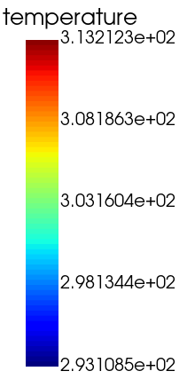
Problem Description
Temperature Contour Plot using
DOE is defined using
Cold Inlet Velocity (m/s) | Hot Inlet Velocity (m/s)
0.1 | 0.8
0.2 | 1.0
0.3 | 1.2
0.4 | 1.4
0.5 | 1.6
0.6 | 1.8
0.7 | 2.0
Average Temperature at the outlet is extracted as a Response
DOE is run sequentially using “nested for loop”
Boundary Condition setup, Initialization and Iterations are performed using PyFluent API
Response is extracted using PyFluent API and store in a 2D Numpy Array
Cold Inlet
Hot Inlet

Slide 4
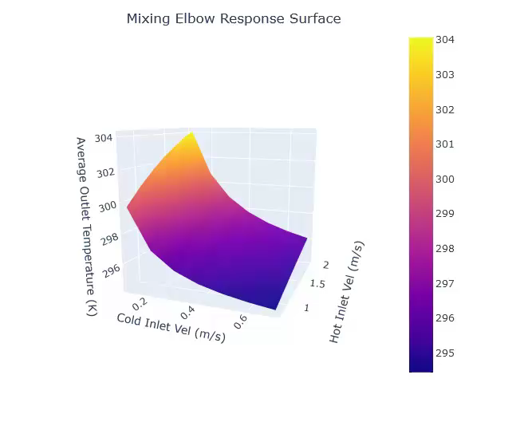
Response Surface
3D Interactive Response Surface using

Slide 5
Machine Learning
Type: Supervised Machine Learning
Task: Regression
Elements:
2 Features: Cold Inlet Velocity, Hot Inlet Velocity
1 Label: Mass Weighted Average of Temperature at the Outlet
Data Pre-Processing Pipeline; add polynomial features
Train-Test Split (80-20)
Model Selection: Linear Regression, XGBoost, TensorFlow (fully connected deep neural network)
Cross-Validation
Hyper Parameter Tuning
Model Fitting and Prediction
R2 Scores

Slide 6
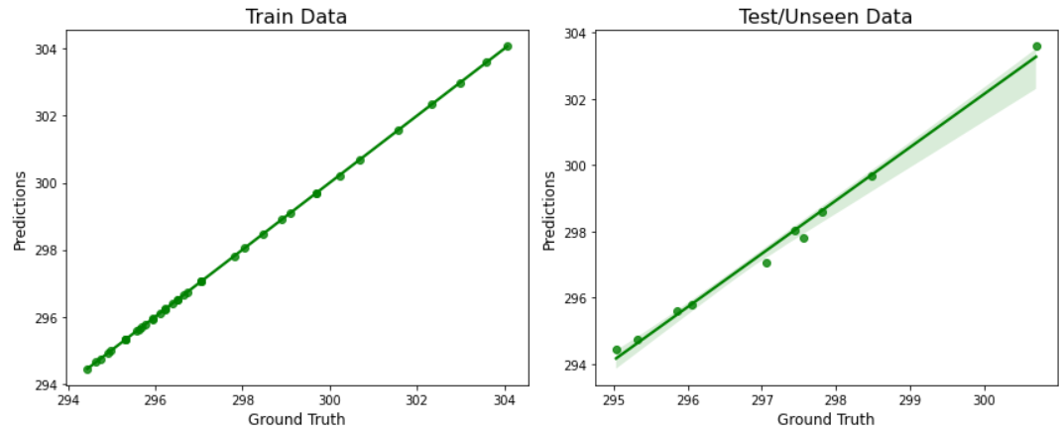
Parity Plot for XGBoost
R2 Score: 1.0
R2 Score: 0.83
Parity Plot using
&

Slide 7
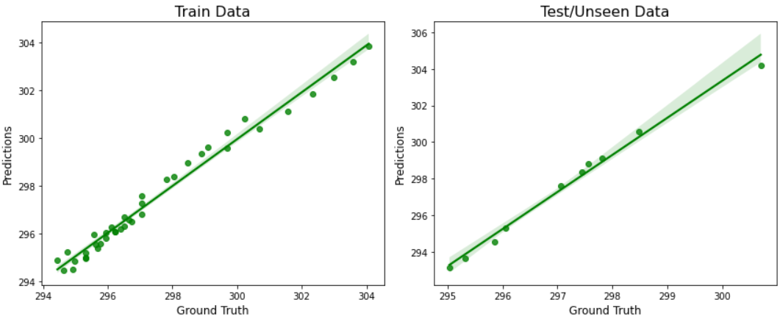
Parity Plot for Linear Regression with Polynomial Features
R2 Score: 0.98
R2 Score: 0.72
Parity Plot using
&

Slide 8
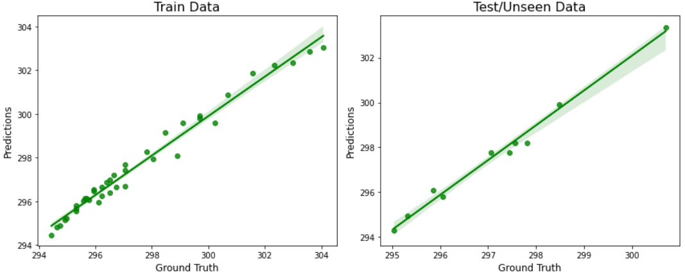
Parity Plot for a TensorFlow Neural Network Model (WIP)
R2 Score: 0.96
R2 Score: 0.82
Parity Plot using
&

Slide 9
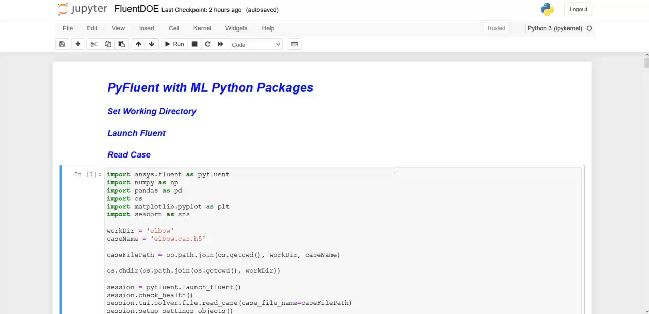
Video Demo

